Slide 1


Unveiling Financial Insights: Leveraging Advanced Data Analysis
Submitted by
Sukant R [927623bBAD114]
sukantravi005@gmail.com
MKCE ,Karur.

Slide 2

PROBLEM STATEMENT / DESCRIPTION:
Develop a data analysis and visualization solution for historical stock price data retrieval, analysis, and visualization. The solution should efficiently fetch historical stock price data of specific Stock or ETFs using the y-finance library, process the data to calculate daily returns, and generate insightful visualizations including a time series plot of closing prices and a histogram depicting the distribution of daily returns.

Slide 3
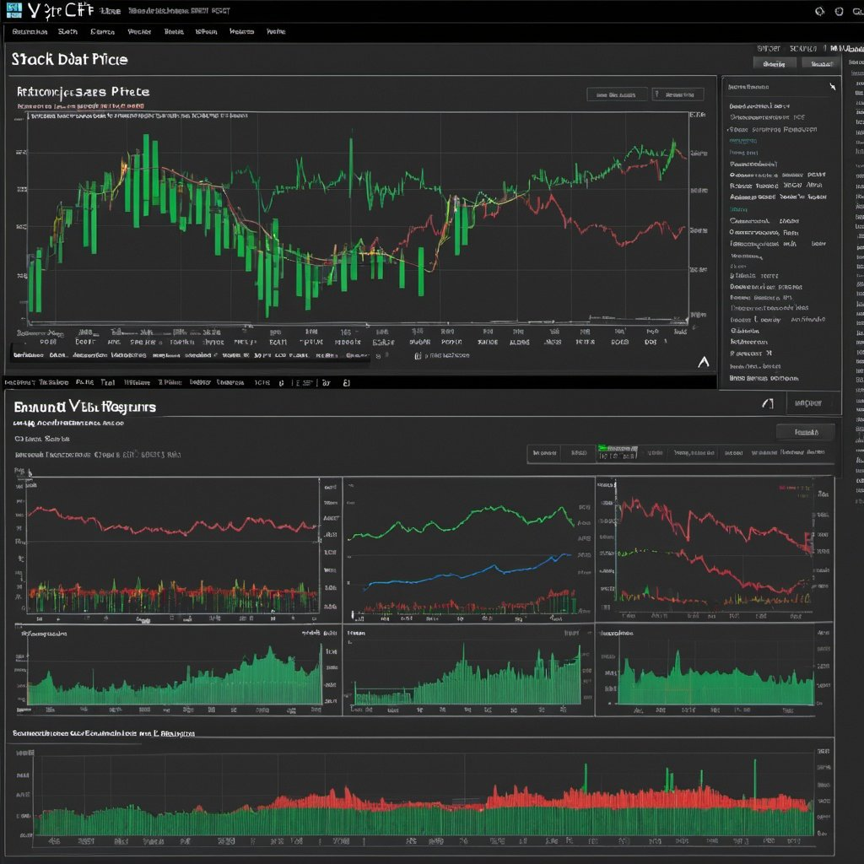
PROBLEM STATEMENT / DESCRIPTION:
Implement a Python script capable of fetching historical stock price data of specified stock symbol and date range.
Calculate daily returns based on the adjusted closing prices of the stock.
Generate a time series plot illustrating the trend of closing prices over time for the selected stock.
Create a histogram visualizing the distribution of daily returns, aiding in understanding the volatility and risk associated with the stock.
Allow for customization of visualization parameters such that color schemes.

Slide 4
ABSTRACT :
The current code aims to visualize the historical closing prices and return distribution of a specified stock (or) ETF using data fetched from Yahoo Finance. However, the problem arises when the code does not account for potential errors or exceptions that may occur during the data retrieval process, leading to potential disruptions in the analysis workflow. Additionally, the code lacks robustness in handling missing or incomplete data, which could skew the accuracy of the visualizations and subsequent analysis. Furthermore, there is a potential risk of relying solely on a single stock symbol for analysis, limiting the scope of insights derived from the visualizations. Hence, there is a need to enhance the code's fault tolerance, data integrity, and analytical breadth to ensure reliable and comprehensive financial analysis.

Slide 5
PROPOSED SOLUTION :
The proposed solution is a Python script designed to empower users to analyze historical stock
price data interactively. It begins by prompting users to select a seaborn theme from a curated list,
ensuring that the subsequent visualizations are presented in a style that suits their preferences.
After theme selection, users are prompted to input details such as the stock symbol, start date,
and end date for the desired data retrieval. Leveraging the yfinance library, the script downloads
the historical stock price data corresponding to the provided parameters. It then calculates the
daily returns based on the adjusted closing prices of the stock, setting the stage for insightful analysis.
The script proceeds to visualize the data in two distinct plots: the first showcases the closing prices
of the stock over time using seaborn's lineplot() function,while the second illustrates the distribution of
daily returns through seaborn’s histplot() function. Both visualizations are thoughtfully designed,
featuring clear titles, axis labels, and layout adjustments for optimal readability. By encapsulating
these functionalities within a cohesive script, users can seamlessly explore and gain valuable insights
from historical stock price data with ease and flexibility.

Slide 6
REAL LIFE APPLICATION:
1. Financial Analytics Dashboard: Access real-time stock data and market trends with our intuitive analytics dashboard.
2. Trading Platform: Empower your trading strategies with real-time market data and analysis tools on our platform.
3. Algorithmic Trading System: Automate your trading decisions based on real-time data and predefined strategies.
4. Investment Research Platform: Conduct comprehensive research and analysis for informed investment decisions on our platform.

Slide 7
HARDWARE AND SOFTWARE REQUIREMENTS:
Software : Windows 10 or above
Processor : Intel Core pentium or above.
Ram : 4 GB RAM (8 GB preferred)
Storage : 15 GB available hard disk space
Others :Internet connection
Application : Jupyter notebook or Anaconda(preferred)
-If not : google-colab

Slide 8
PROJECT CODE:
import pandas as pd
import numpy as np
import matplotlib.pyplot as plt
import seaborn as sns
import yfinance as yf
stock=input("Enter the stock name : ").upper()
sdate=input("Enter the starting date(yyyy-mm-dd) : ")
edate=input("Enter the ending date(yyyy-mm-dd) : ")
def custom():
print("Available theme:\n1. Dark.\n2. White.\n3. Ticks.\n4. Darkgrid.\n5. Whitegrid.\n")

Slide 9
PROJECT CODE:
num=int(input("Select theme : "))
if num==1:
styleset="dark"
cl="cyan"
elif num==2:
styleset="white"
cl="red"
elif num==3:
styleset="ticks"
cl="green"
elif num==4:
styleset="darkgrid"
cl="cyan"
elif num==5:
styleset="whitegrid"
cl="blue"
else:
print("Invalid theme! Enter available theme.\n")
custom()
return styleset,cl
sns.set(style="whitegrid")
symbol = stock
data = yf.download(symbol, start=sdate, end=edate)
data.rename(columns={'Adj Close':'Adj_Close'}, inplace=True)
data['returns'] = data['Adj_Close'].pct_change()
plt.figure(figsize=(20,5))

Slide 10
PROJECT CODE:
sns.lineplot(data=data, x='Date', y='Adj_Close', color=‘cl', linewidth=1.5)
plt.title(f'{symbol} Closing Price', fontsize=16)
plt.xlabel('Date', fontsize=12)
plt.ylabel('Price', fontsize=12)
plt.xticks(fontsize=10)
plt.yticks(fontsize=10)
plt.tight_layout()
plt.show()
plt.figure(figsize=(10,5))
sns.histplot(data=data, x='returns', binwidth=0.005, color='green')
plt.title('Return Distribution', fontsize=16)
plt.xlabel('Returns', fontsize=12)
plt.ylabel('Frequency', fontsize=12)
plt.xticks(fontsize=10)
plt.yticks(fontsize=10)
plt.tight_layout()
plt.show()

Slide 11
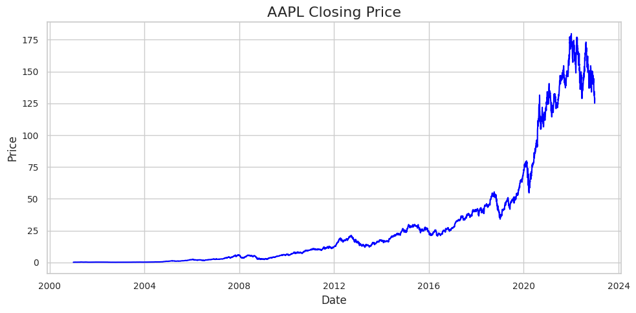
OUTPUT:

Slide 12
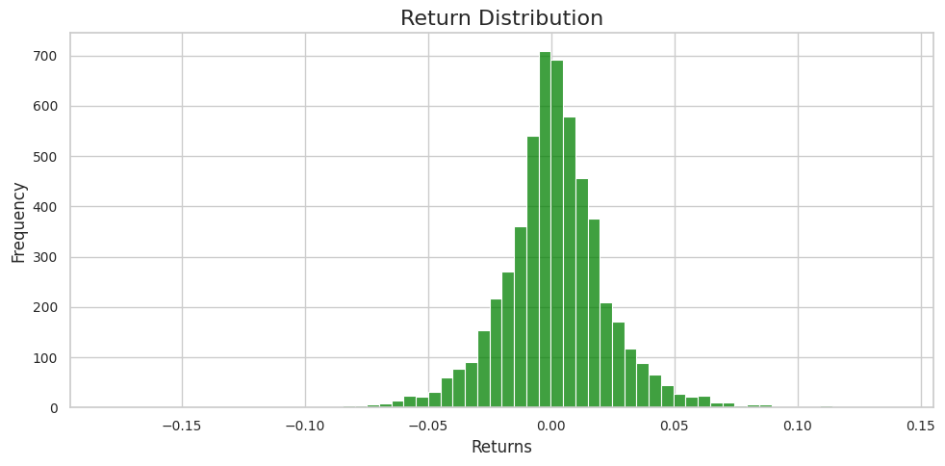
OUTPUT:

